Slide 1
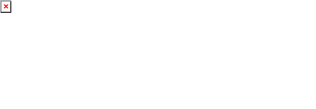
Agent Activity Chart
6/15/2023 12:11 AM
Print User : selenium.automation
Page 1 of 3

Slide 2
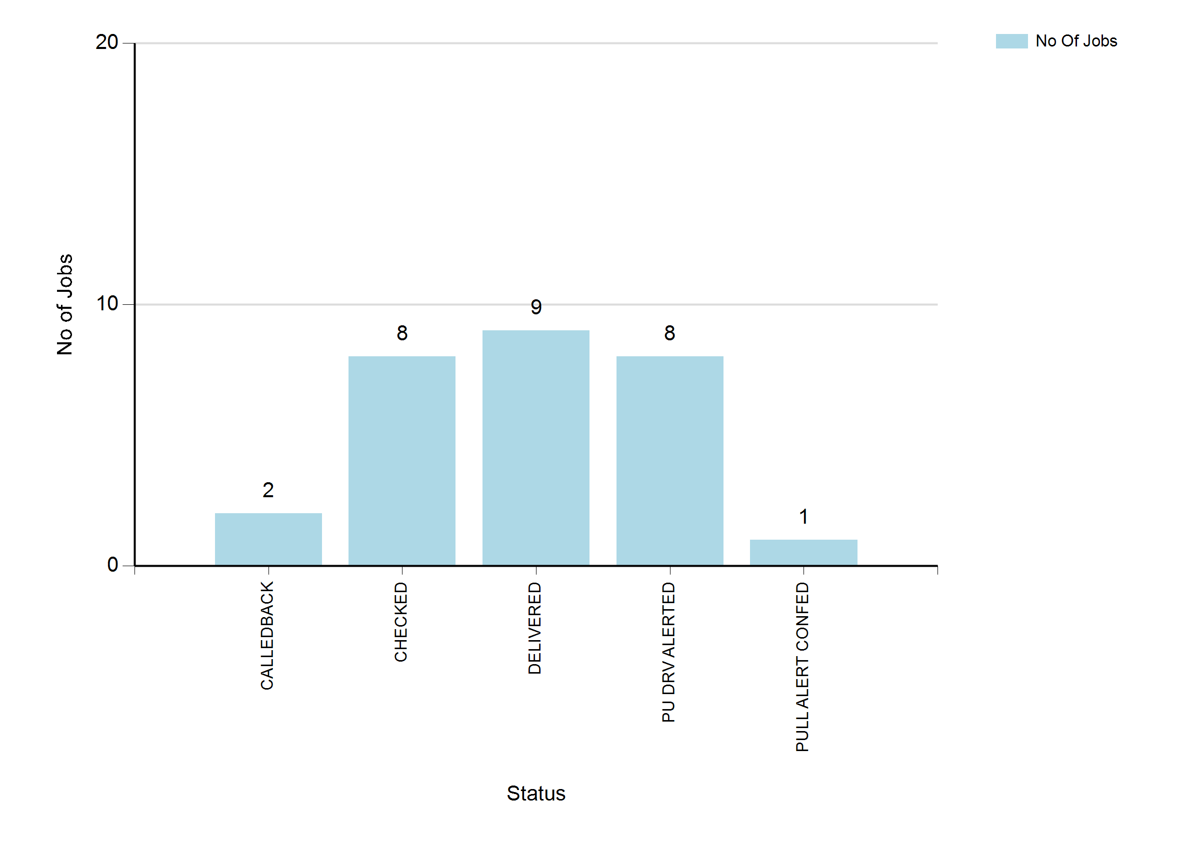
6/15/2023 12:11 AM
Print User : selenium.automation
Page 2 of 3

Slide 3
6/15/2023 12:11 AM
Print User : selenium.automation
Page 3 of 3

